Slide 1

Problem Statement
To detect if a user’s mood and/or wellbeing has improved after a period of a chat.
Deliverables:
A dashboard indicating if each individual user has experienced an improvement in mental health (i.e mood/emotions) at a monthly level.

Slide 2
Our Approaches
Used pretrained Emo Roberta hugging face model with 28 possible emotions
Grouped 28 predicted emotions into sentiments (Positive, Negative, and Neutral) to simplify analysis.
Tried GPT 4o API to label emotions of provided chat history as train/test dataset
Tried sentiment analysis then predict the specific emotion based on each sentiment.

Slide 3
Balanced and grouped by day making sure sentiments were even, then grouped them month.
Analyzed emotional progression over time with certain keywords i.e. ‘good morning’, ‘goodnight’
A visualisation of accurately detected emotions within conversation and dashboard to oversee user’s mood improvement monthly.

Slide 4
Approach | Pros | Cons
EmoRoBERTa (HuggingFace) | Pretrained models Fast and easy to use Cost efficient | Limited to 28 emotions Less flexible for custom labels
ChatGPT 4o API | Flexible and powerful Customizable emotions and sentiments | High cost for large datasets
Distilbert | Smaller model therefore faster training speed Supports transfer learning | Was not optimized for sentiment analysis

Slide 5
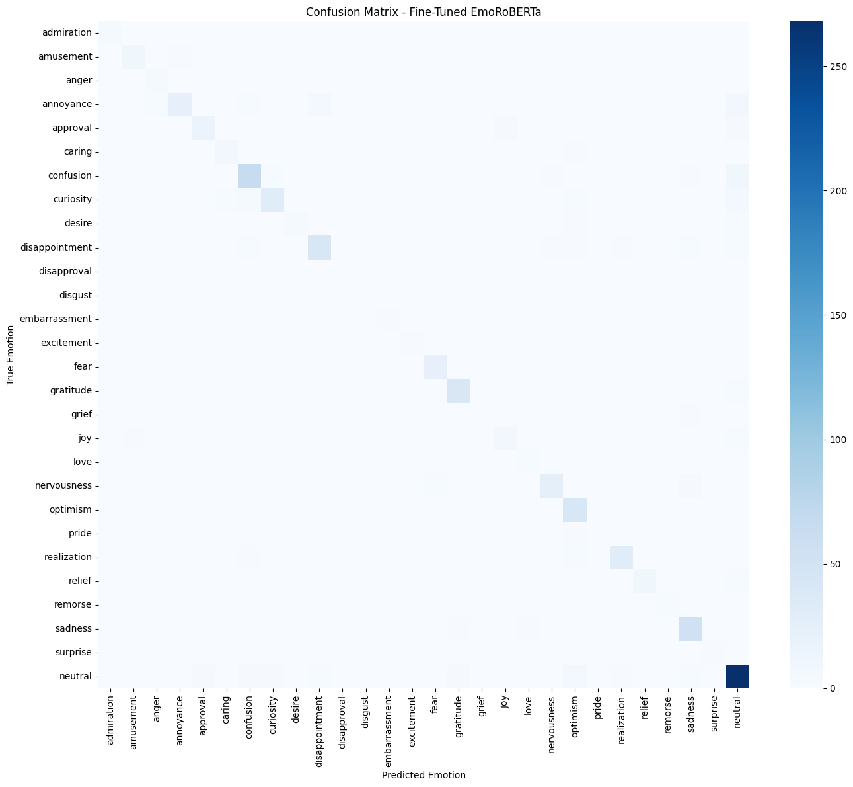
Our Final Result
Using pre-trained model from huggingface EmoRoBERTa that was trained on 58000 comments.
Fine tuned the model based on provided chat history dataset that is labelled by Gpt 4o.
76.96% emotion accuracy
(https://huggingface.co/arpanghoshal/EmoRoBERTa)
Notes:
Emotions Accuracy: 0.7696

Slide 6
Our Final Result
Grouped emotions into sentiments (pos,neu,neg), as sentiment can help to track progress while emotion can spot subtle patterns.

Slide 7
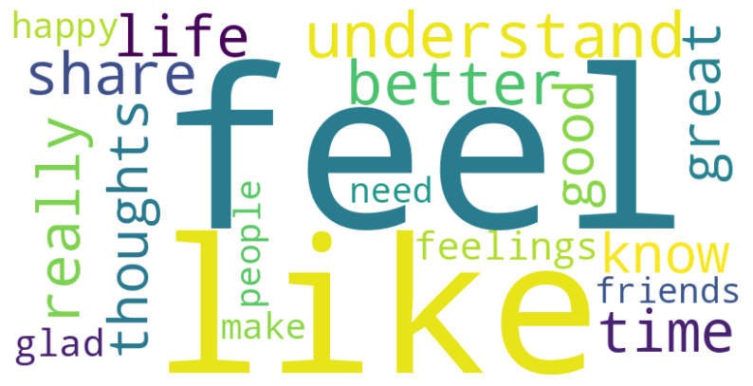
Visualization
Based on User 1 Chat
Word Cloud
Using sentiment scoring system, it identifies keywords from provider that created positive change

Slide 8
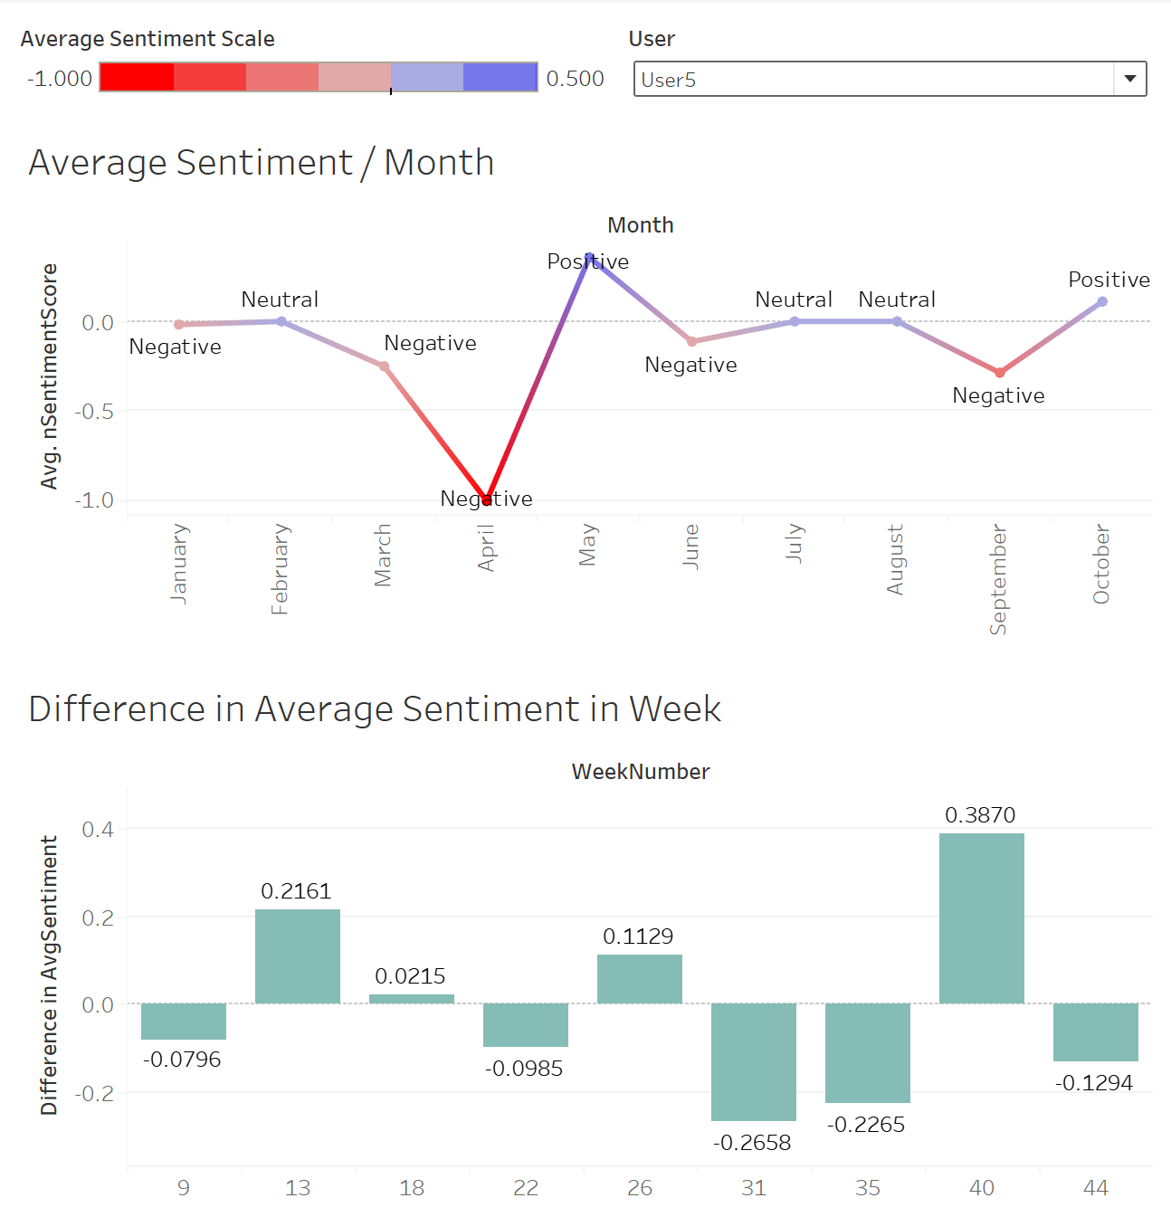
Final Dashboard
Based on User 5 Chat
Average Sentiment/Month
Trend in sentiment across the months.
See overall sentiment improvements, deprovement or stable.
Improvement of Client Moods (Difference in Average Sentiment in Weeks)
Displays magnitude of change of sentiment compared to previous week
Positive change = a tall upwards bar

Slide 9
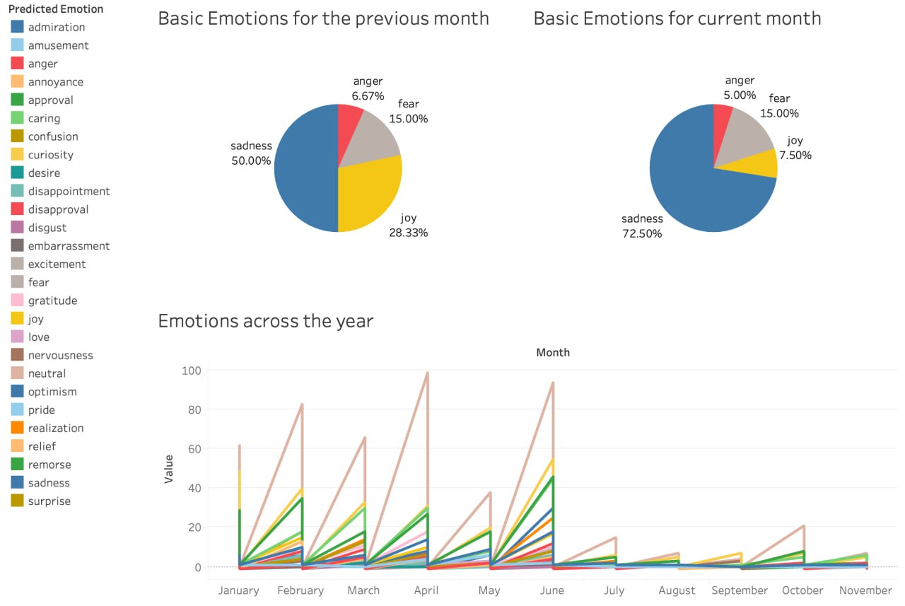
Final Dashboard
Based on User 5 Chat
Basic emotions each month
Pie charts shows dominant emotions
Gives quick emotional snapshot to compare emotions in previous and current month.
Emotions across the year
Tracks all 28 emotions month-by-month
Helps identify recurring emotional patterns or spikes

Slide 10
Thank you!
Thank you!
Thank you!
Thank you!
Thank you!
THOUGHTFULL TEAM 2

Slide 11
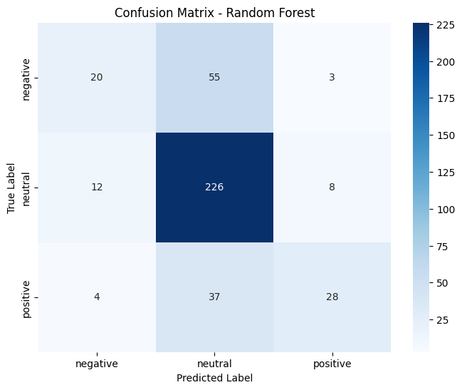
SUPERVISED LEARNING
Used more data for training from kaggle to improve sentiment analysis
Decided to use sentiment alongside emotion, as sentiment can help to track progress while emotion can spot subtle patterns
Gradient Boosting, SVM and Logistic Regression accuracy of ~ 70%

Slide 12
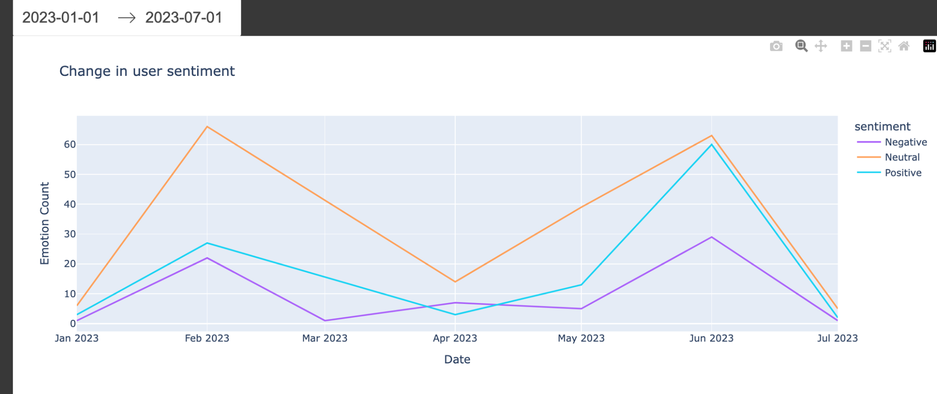
Final Visualizations
Based on User 1 Chat
Built using Dash
Includes a date filter to explore how user sentiment changes over the months.

Slide 13
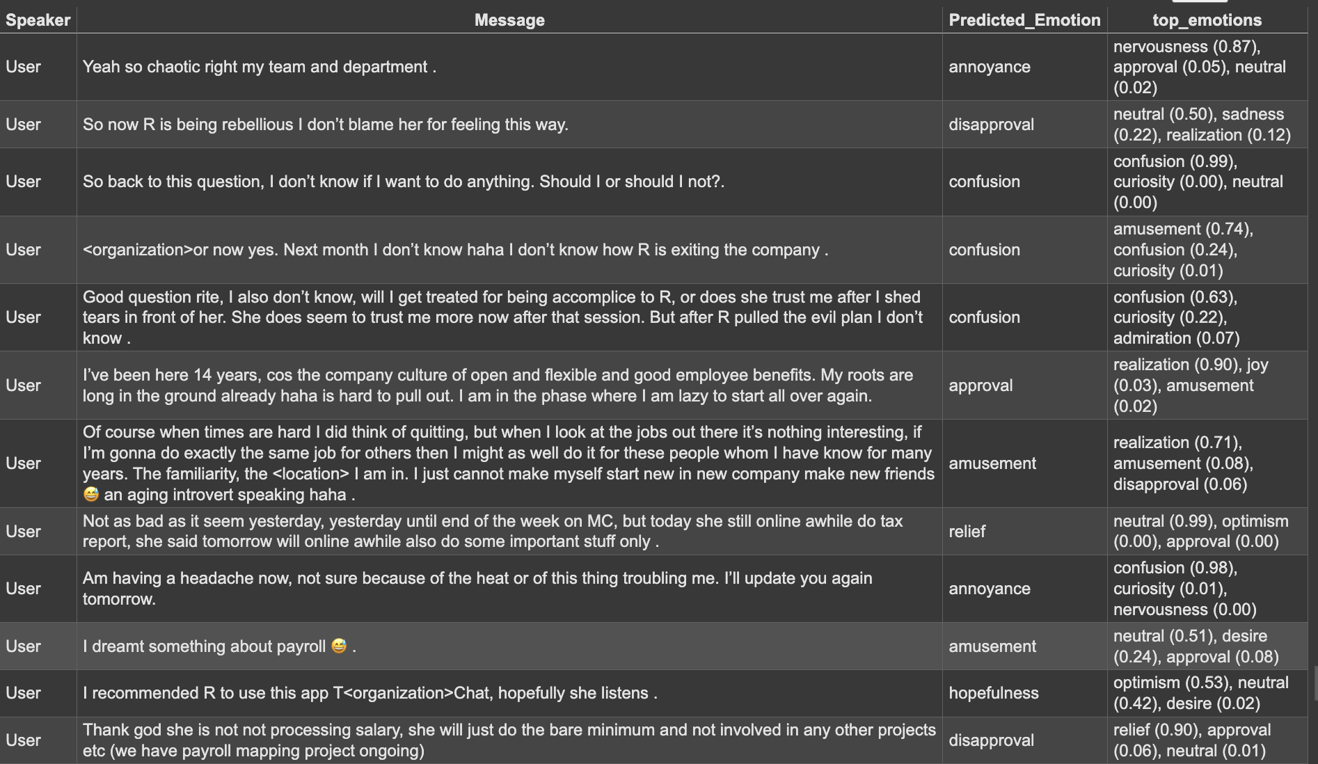
MOOD DETECTION
Pre-trained model from huggingface roBERTa that was trained on 58000 comments

Slide 15
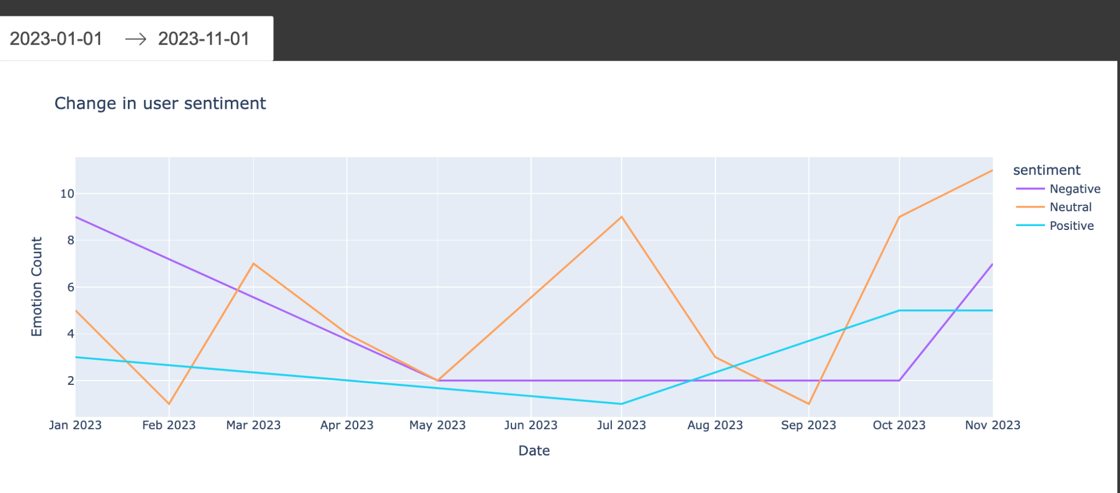
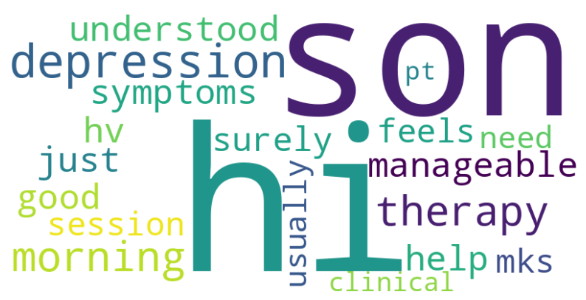
Chat2

Slide 16
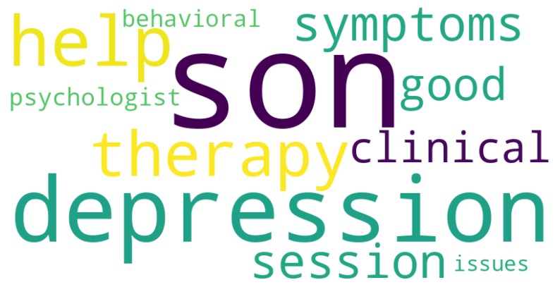
Chat3

Slide 17
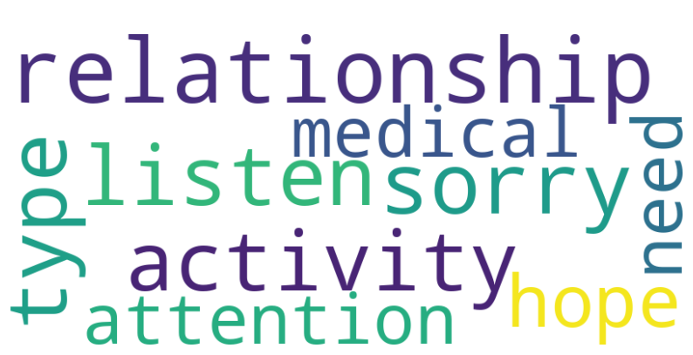
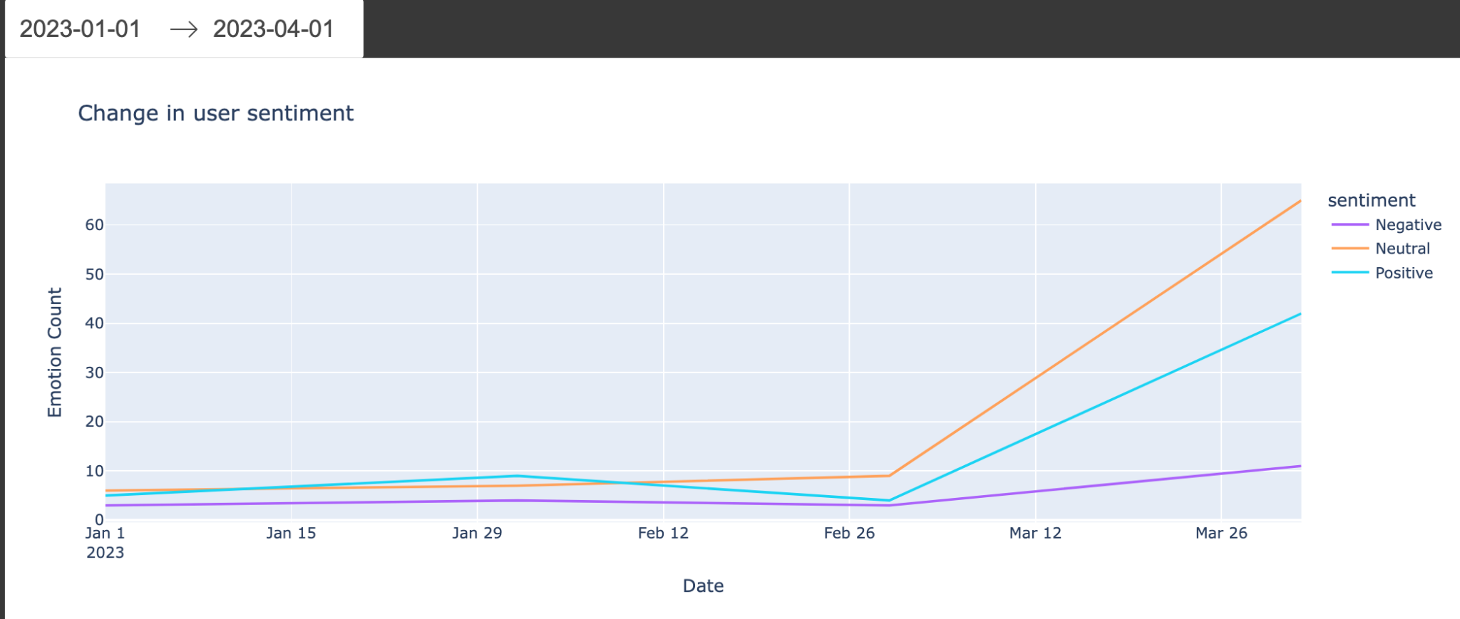
Chat4

Slide 18
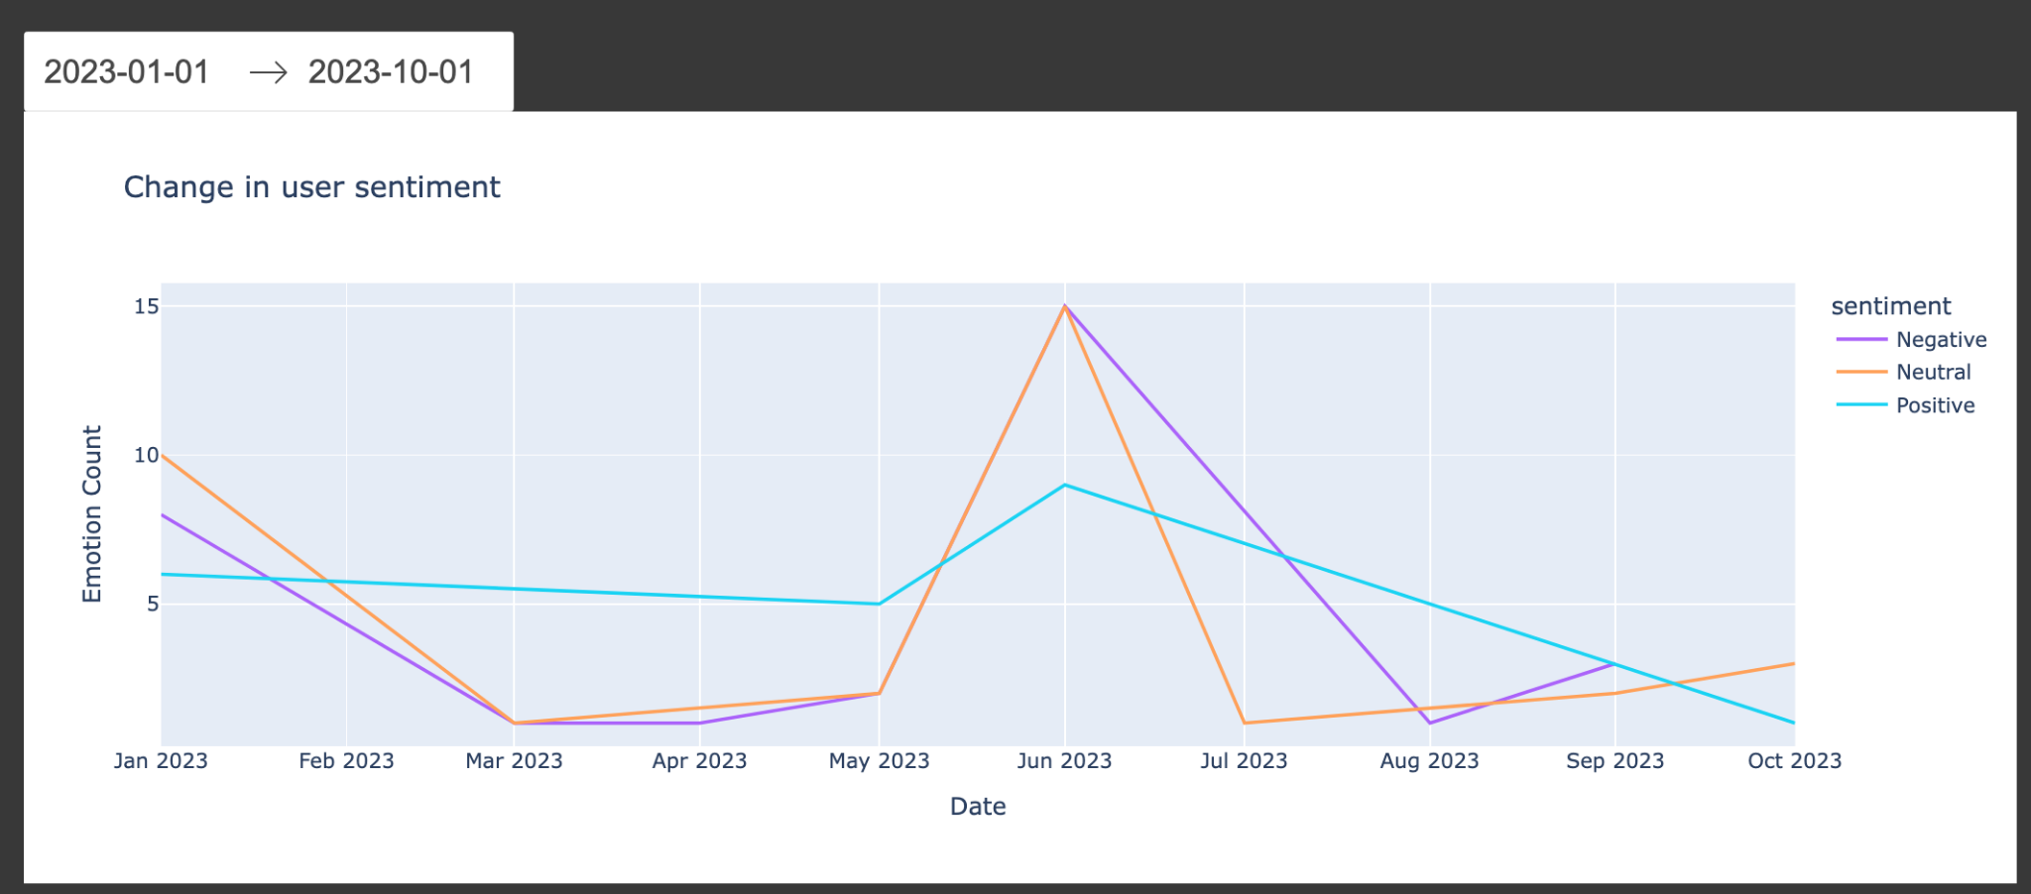
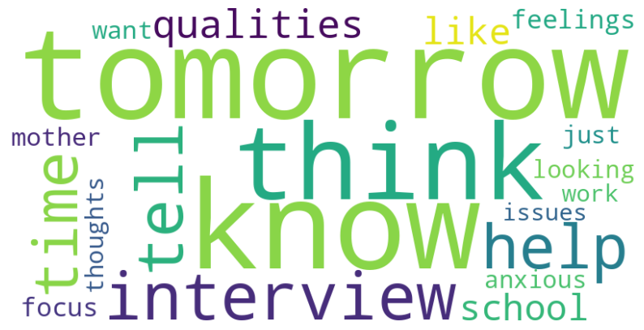
Chat5

Slide 19
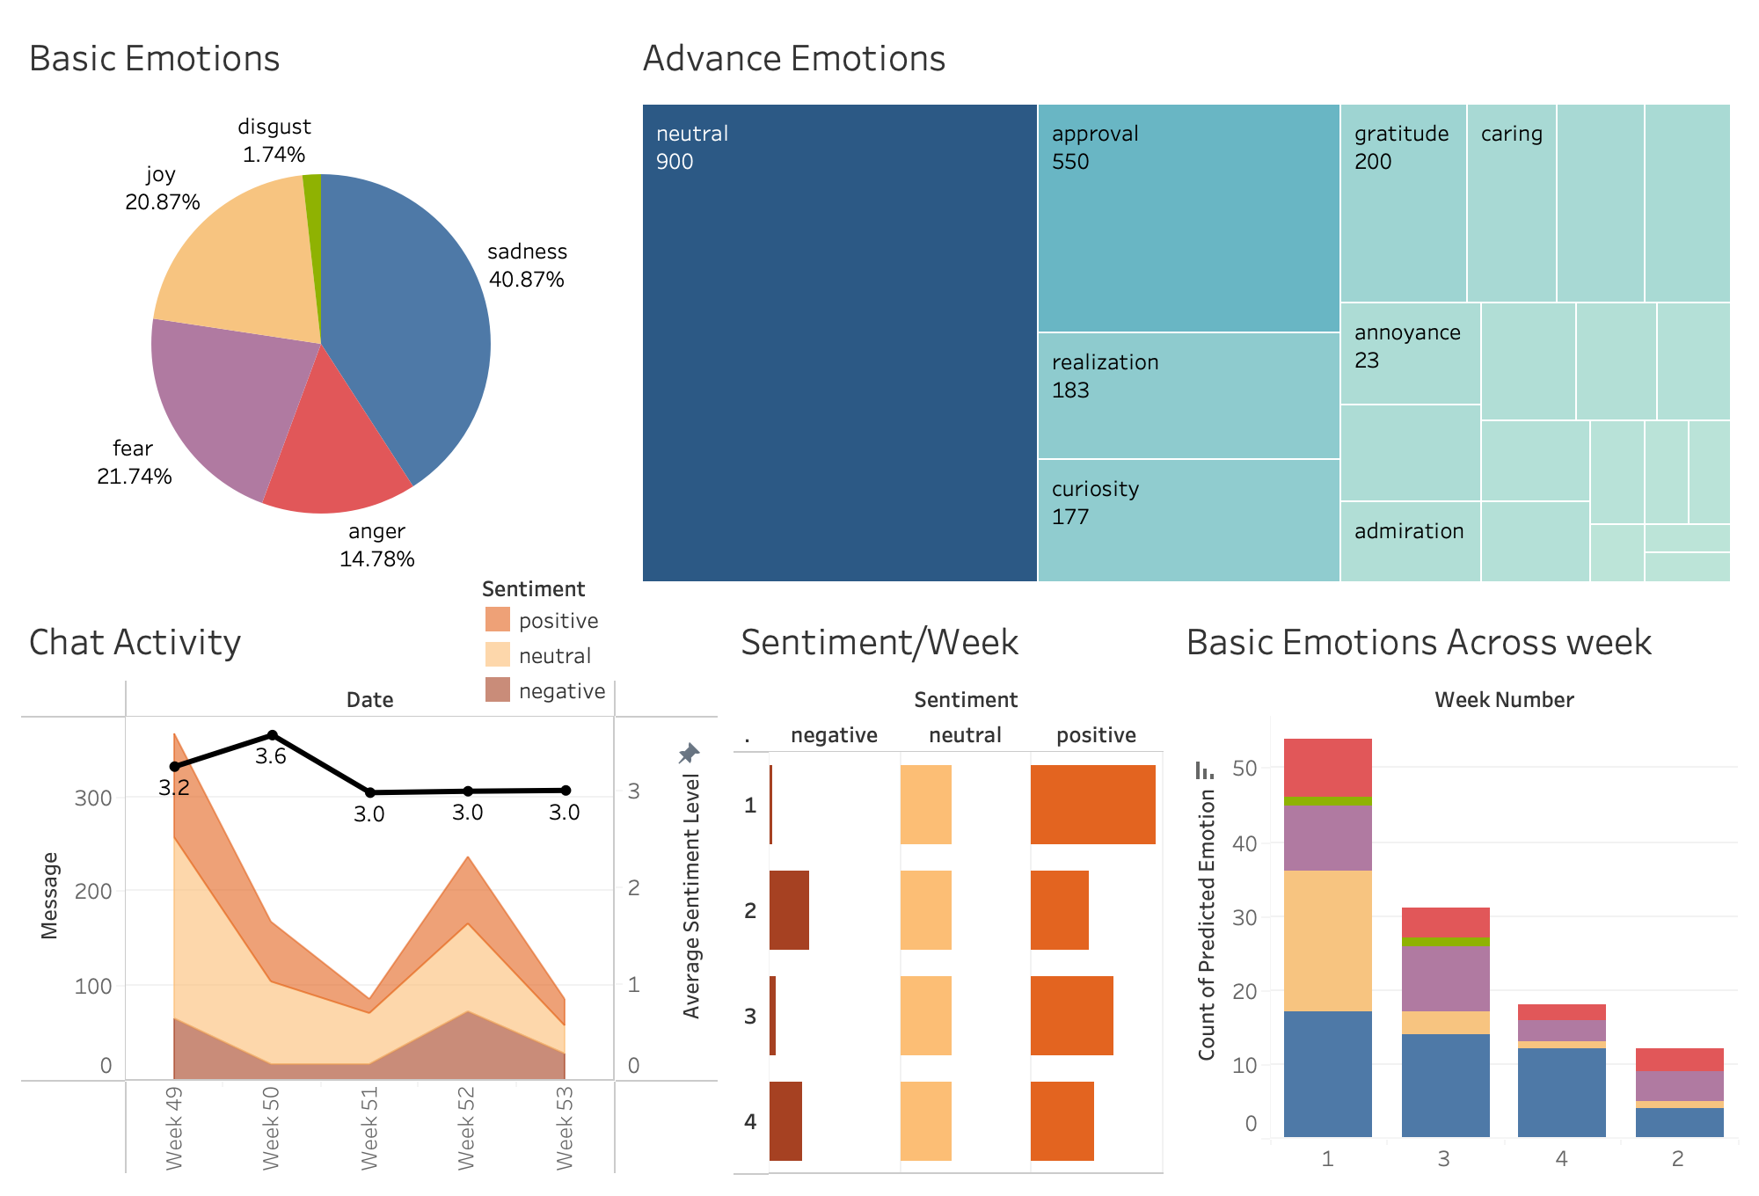
DASHBOARD PLANS
Progression
Breaking down the emotional and sentimental activity over a few weeks

Slide 20
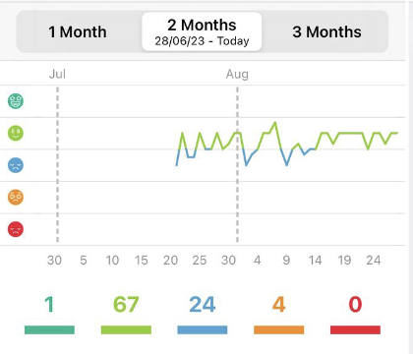
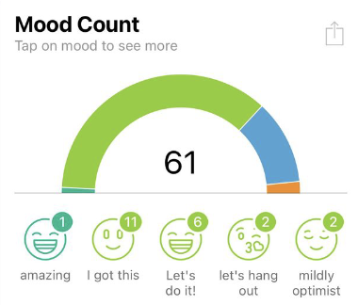
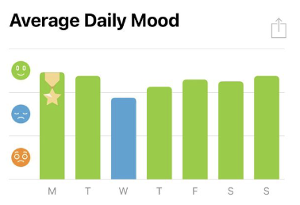
DASHBOARD PLANS
Next step(s)
Improve the accuracy even more, hoping to get more than 80%.
Improve the layout and overall presentation of the dashboard
Final step
Creating the finalized dashboard

Slide 21
QUESTIONS
Could timestamps be provided for the dataset?
What would the team want to have represented in the dashboard?
Is each chat is from a different or same person?

Slide 22
Thank you!
THOUGHTFULL TEAM 2

Slide 23
DRAFTS

Slide 24
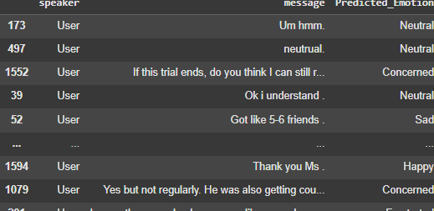
01
02
03
Environment Setup
Emotion Classification
Assign Days
Used GPT 4o to run classify emotions
We trained our model using Logistic Regression, after converting chat messages into numerical features using TF-IDF vectorization, to predict the emotion of each message.
Automatically assigned day numbers to messages by detecting keywords that indicate the start of a new day.
04
Output
THOUGHTFULL TEAM 2

Slide 25
NLP
For Future Use Cases
Sentiment Analysis Using NLP
Using API
Transfer Learning
Easier to integrate
We got the most accurate results from using the OpenAI API but it is costly at 20c per 700 rows
Explore how knowledge gained through one task or dataset is used to improve model performance on another related task and/or different dataset
Preprocessing data for model training
Logistic regression modeling to discriminate emotions
Generate predictions
Evaluation of model
THOUGHTFULL TEAM 2
Least Efficient

Slide 26
Using API
Pros
Cons
More accurate emotion detection
Scalability,handle varying amounts of data
High token limits compared to traditional NLP models like BERT (maximum token limit of 512 tokens) -> might further explore Longformer or Big Bird
Cost Concerns. It will be costly to run the API for hundreds of lines. (We can combat this by exploring free but less accurate APIs)
Privacy concerns, whether it is shared with API provider, used for training future models, or analyzed in ways they did not consent to.
THOUGHTFULL TEAM 2

Slide 27
POTENTIAL FUTURE PLANS
Next step(s)
Find and use free models with higher accuracy
Use HuggingFace (a free API) which will have reduced accuracy as it is an older model. This allows us to keep the cost as low as possible.
Final step
Creating mockup dashboards (Draft)

